Slide 1
Announcement
Midterm: Feb 23, 2026. In class
What to expect:
True/False
Short answer
ER diagram (simple one)
How to draw ER diagram: [you must write your student ID]
ipad
Draw.io
Paper (click picture with your phone)
Feb 13 (Friday): Review class
By Feb 11th, email me what contents you wanted me to cover again

Slide 2
SQL Intro
Instructor: Kazi Amit Hasan

Slide 3
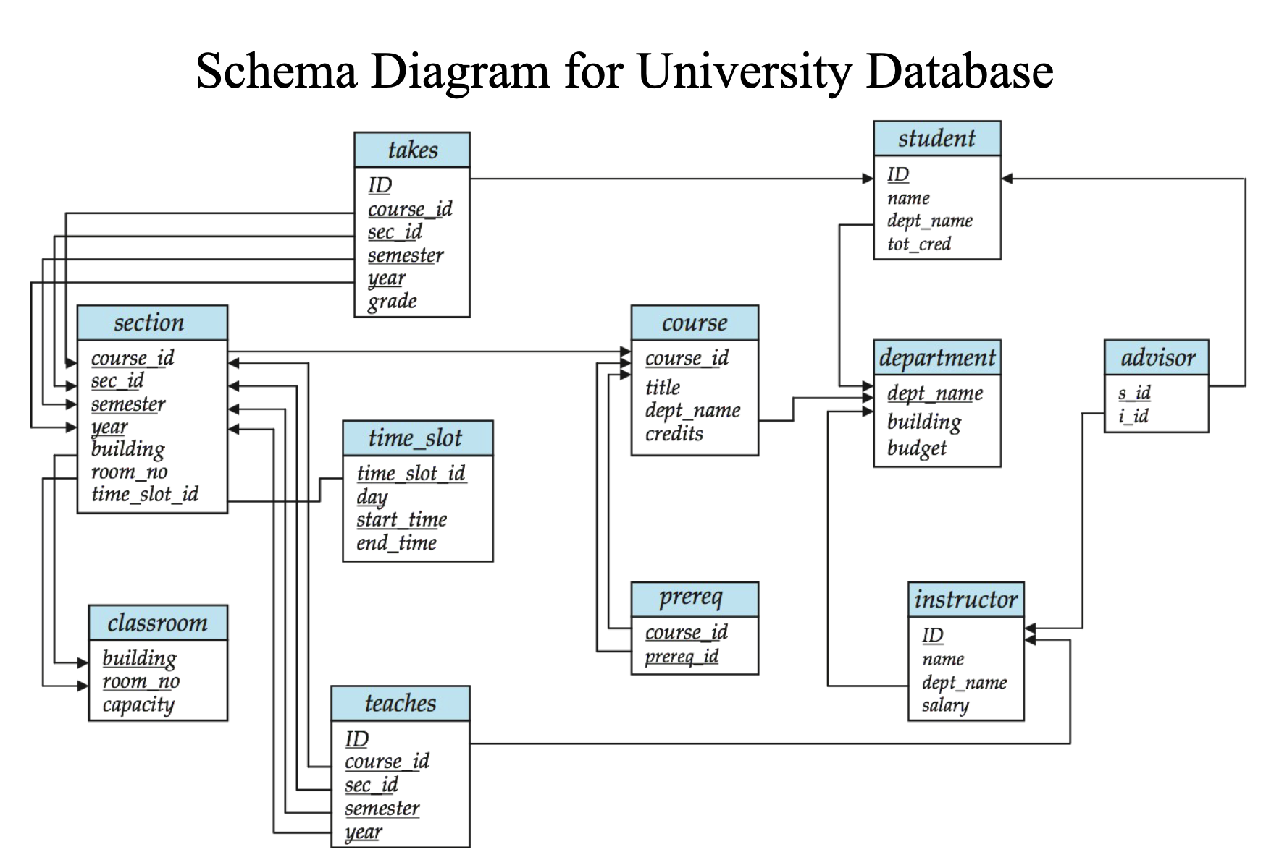

Slide 4
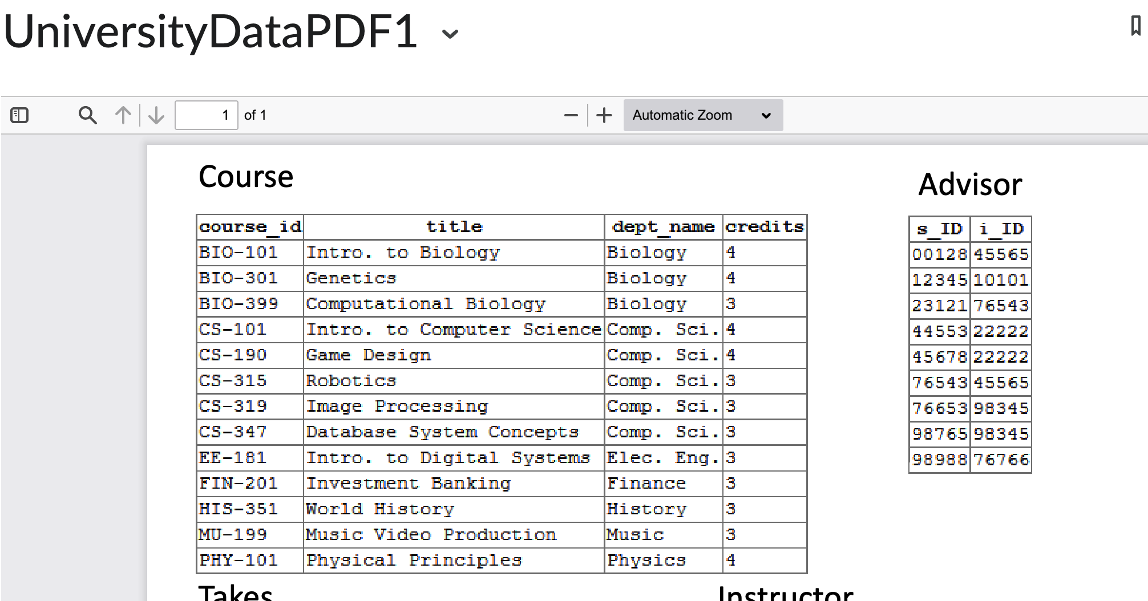
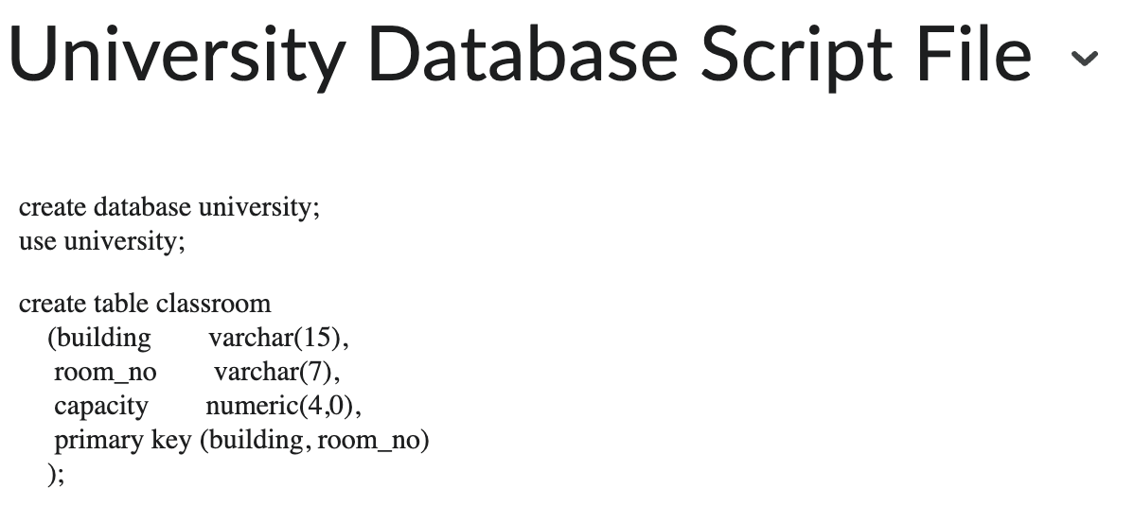
How we are going to learn
Also other external
links
Attend the class the learn about the queries
Review the slides
Try them by your own!
University Database Script File
UniversityDataPDF1

Slide 5
With SQL we can
execute queries against a database to answer questions • retrieve data from a database • insert records in a database • update records in a database • delete records from a database • create new databases • create new tables in a database • create views in a database • set security permissions on database objects • ....and more

Slide 6
Important Commands
SELECT - extracts data from a database • UPDATE - updates data in a database • DELETE - deletes data from a database • INSERT INTO - inserts new data into a database • CREATE DATABASE - creates a new database • CREATE TABLE - creates a new table • ALTER TABLE - modifies a table • DROP TABLE - deletes a table • CREATE INDEX - creates an index (search key) • DROP INDEX - deletes an index

Slide 7
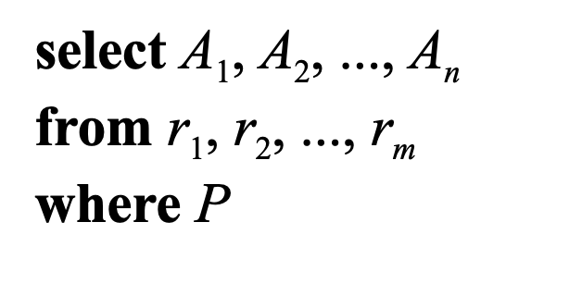
Basic Query Structure
A typical SQL query has the form:
The result of an SQL query is a relation (but it may contain duplicate tuples)

Slide 8
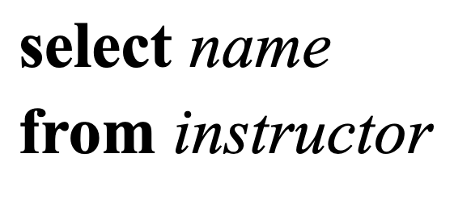
The Select Clause
The select clause lists the attributes desired in the result of a query
Example: find the names of all instructors:

Slide 9
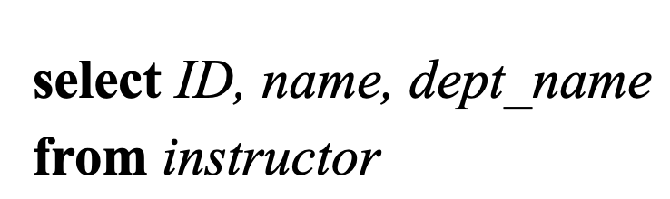
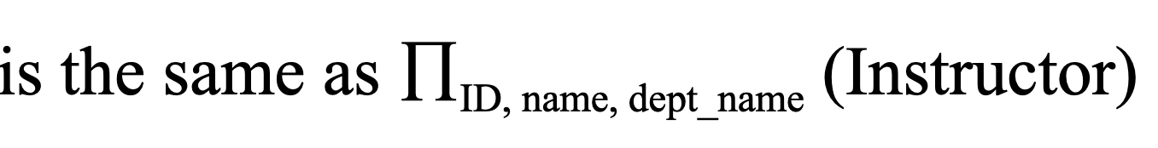
The Select Clause
is the project operation in Relational Algebra

Slide 10
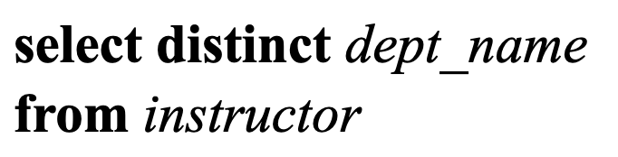
The Select Clause
SQL allows duplicates in relations as well as in query results
To force the elimination of duplicates, insert the keyword distinct after select.
Find the names of all departments with instructors, and remove duplicates

Slide 11

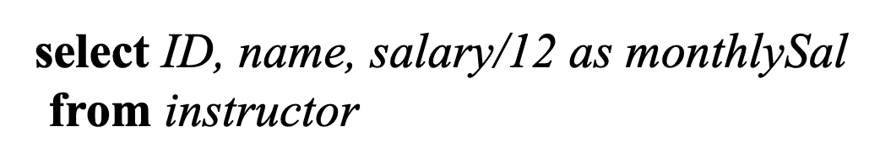
The Select Clause
An asterisk in the select clause denotes “all attributes”
The select clause can contain arithmetic expressions involving the operation, +, –, *, and / operating on constants or attributes of tuples.

Slide 12
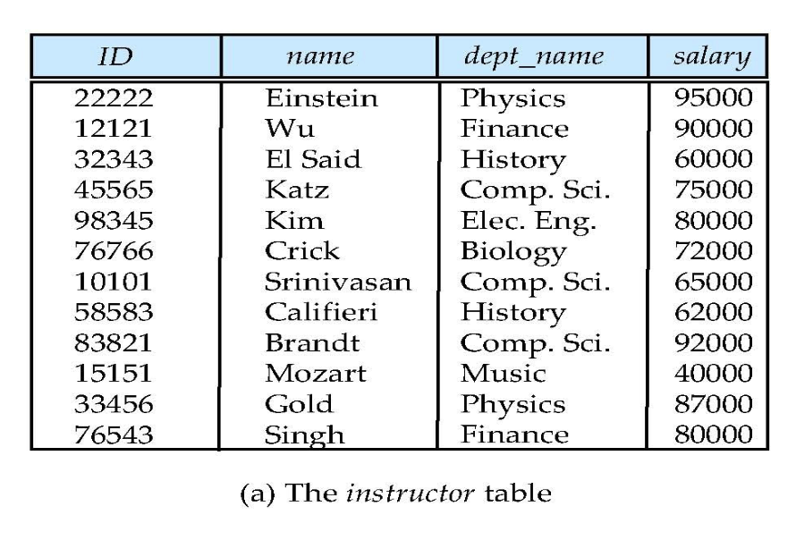
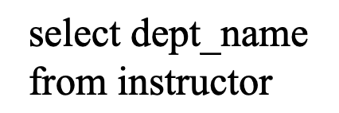
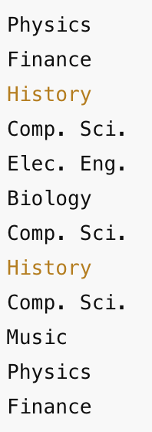
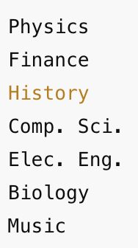
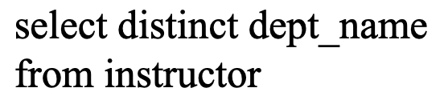
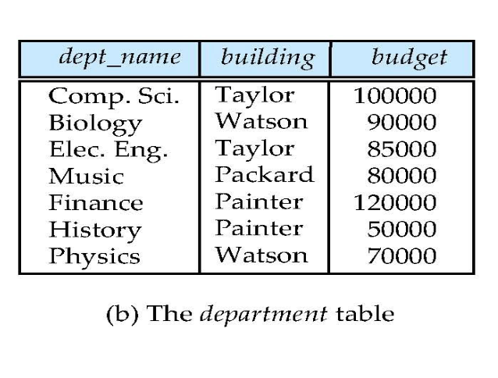
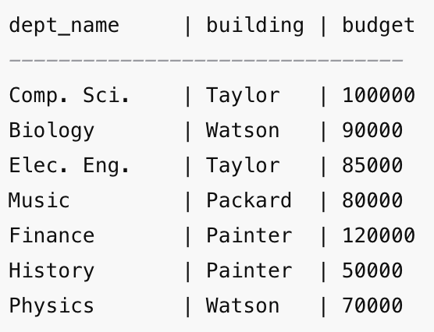
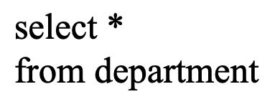

Slide 13
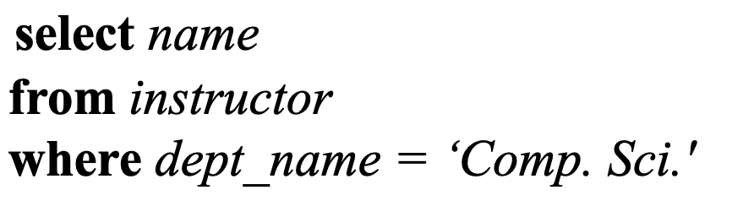
The Where Clause
The where clause specifies conditions that the result must satisfy
Find all instructors in Comp. Sci. dept

Slide 14
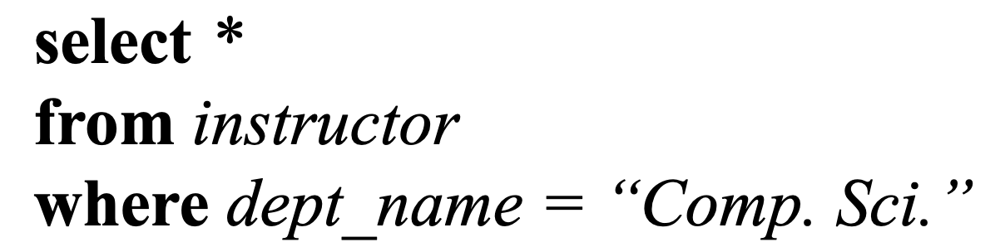
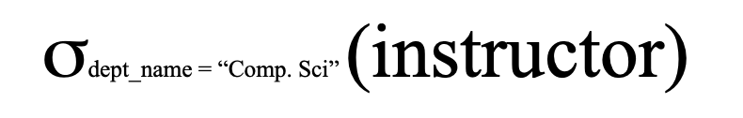
The Where Clause
Implements the select operator in Relational Algebra

Slide 15
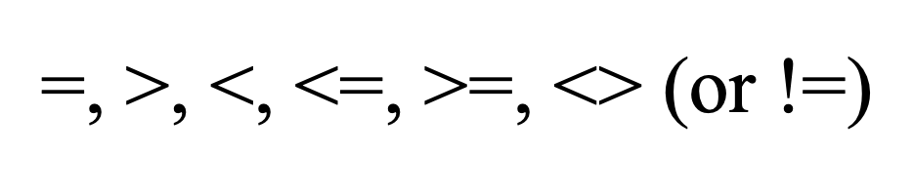
Operators

Slide 16
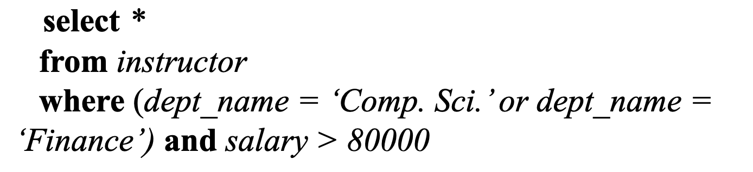
And, Or, Not
Comparison results can be combined using the logical connectives and, or, and not.
Find all instructors in Comp. Sci. or Finance depts with salary > 80,000

Slide 17
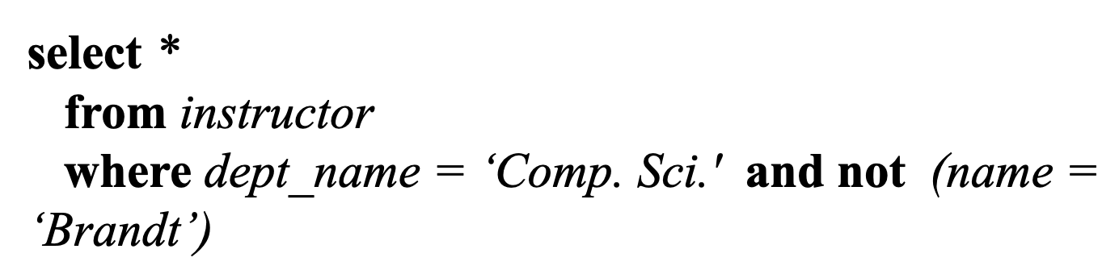
Not
Find all instructors in Comp. Sci. dept but leave out Brandt

Slide 18
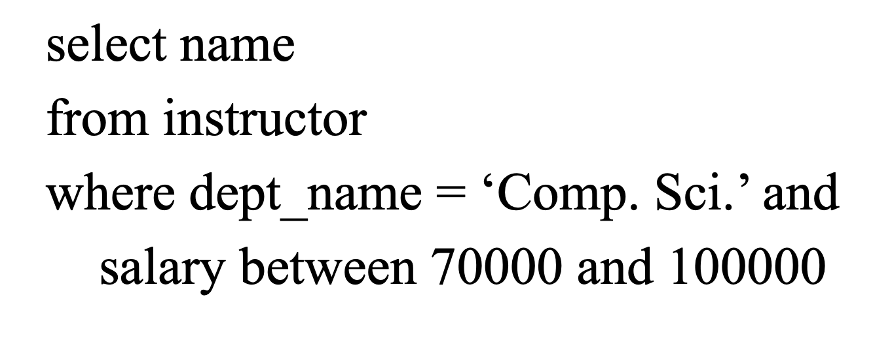
Between

Slide 19
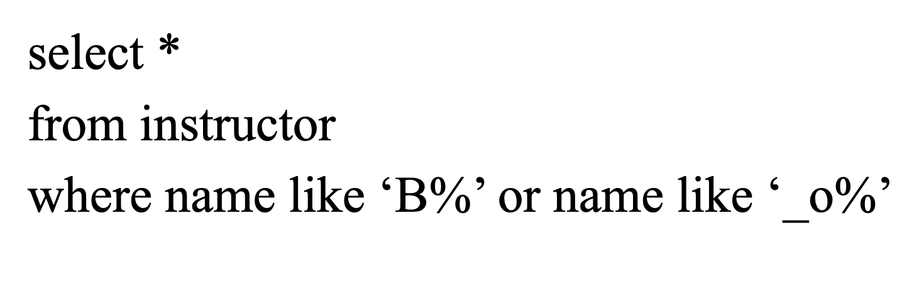
Like
Search for a text pattern
Show me all instructors whose name either starts with the letter B or has ‘o’ as the second letter.”
Matches any name that starts with B
Any name whose second letter is o

Slide 20
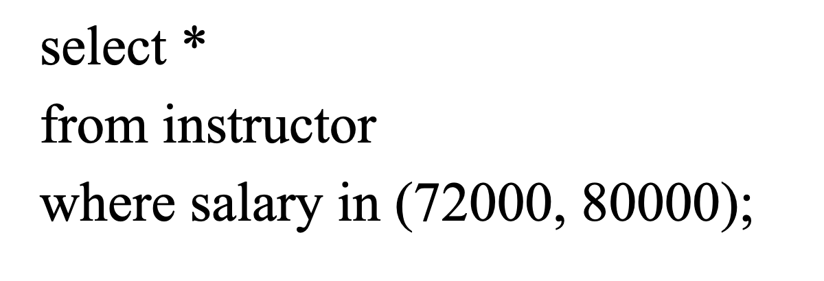
In
possible values for an attribute
Show me all instructors whose salary is either 72,000 or 80,000.

Slide 21
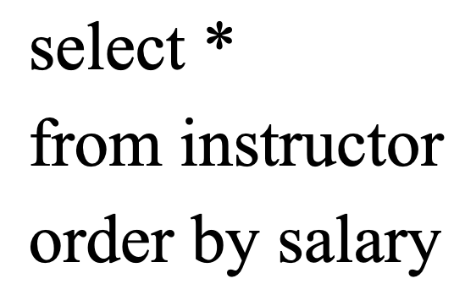
Order by
Orders the output (ASC or DESC)
Show me all instructors, but arrange them in order of their salary, from lowest to highest.

Slide 22
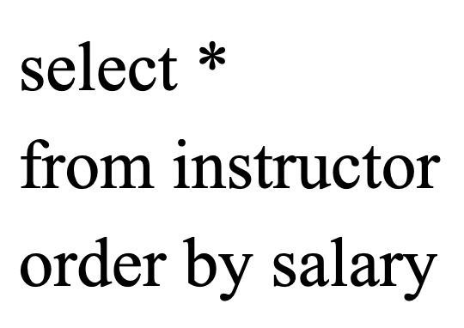
Order by
Show me all instructors, but sort them by salary from highest to lowest.

